Slide 1
Philadelphia Real Estate Tax Downloader
Kyle Elmore

Slide 2

Overview
Parse a list of addresses whose information need to be downloaded
Navigate to Philadelphia's .gov real estate site, specifically the address search page
Input each address into the search bar and parse out the specified addresses' tax information
Temporarily store data in an SQL database
Output all gathered data to an Excel spreadsheet
* Note: For the rest of this presentation, all addresses have been voided from screenshots as the examples are from a client data set

Slide 3
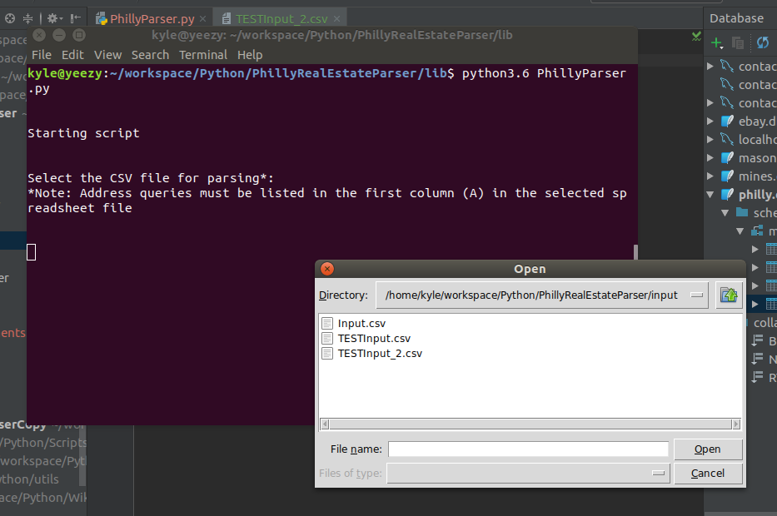
Script Starting
Input the CSV file with predefined addresses to parse

Slide 4
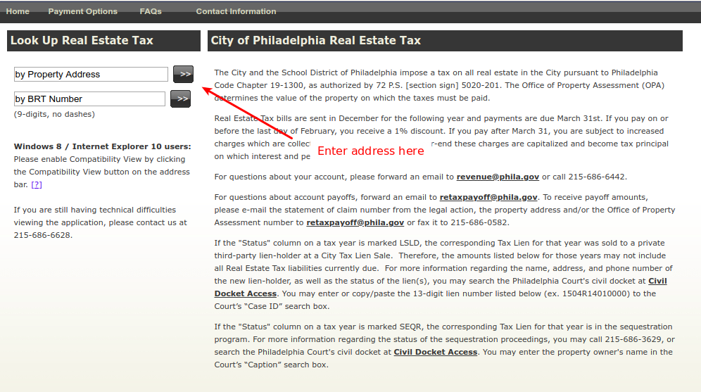
Philadelphia Real Estate Search Page
Navigate to Philadelphia’s real estate search page

Slide 5
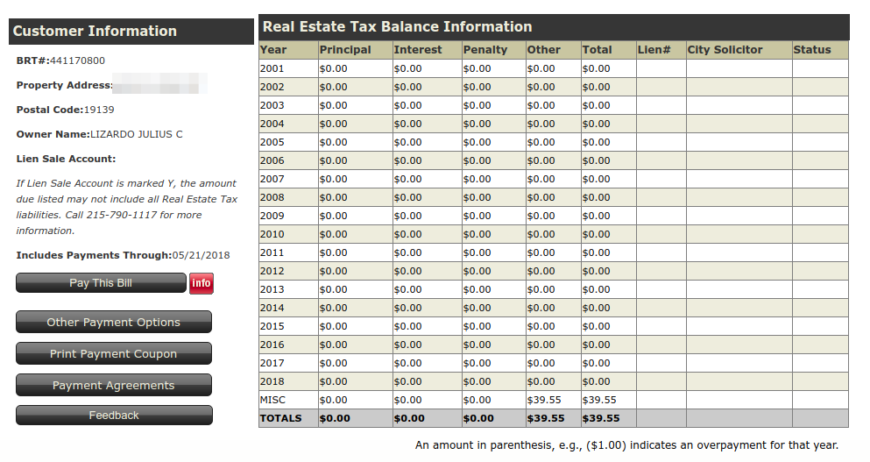
Property Information Search Results
What the search results look like for each property

Slide 6
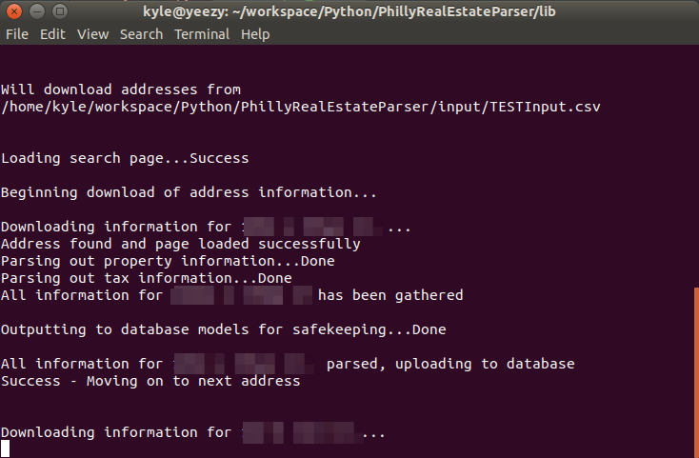
Script Running
An example of the script running

Slide 7
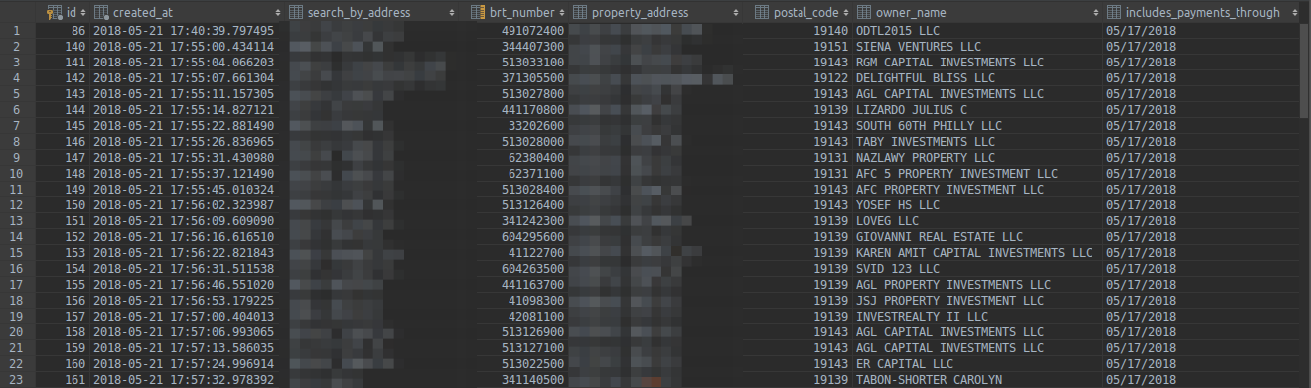
Properties Database
All property information has been input into an SQL database

Slide 8
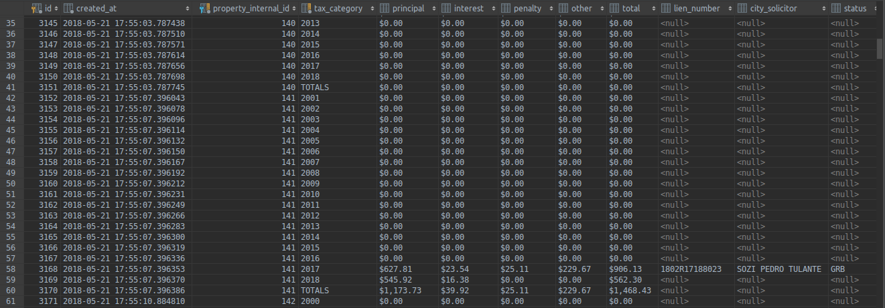
Taxes Database
All tax information has also been input into an SQL database

Slide 9
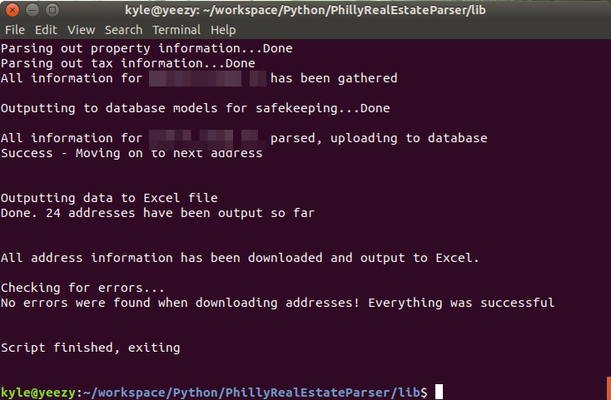
Script Finished
Script wrapping up and outputting data to Excel

Slide 10
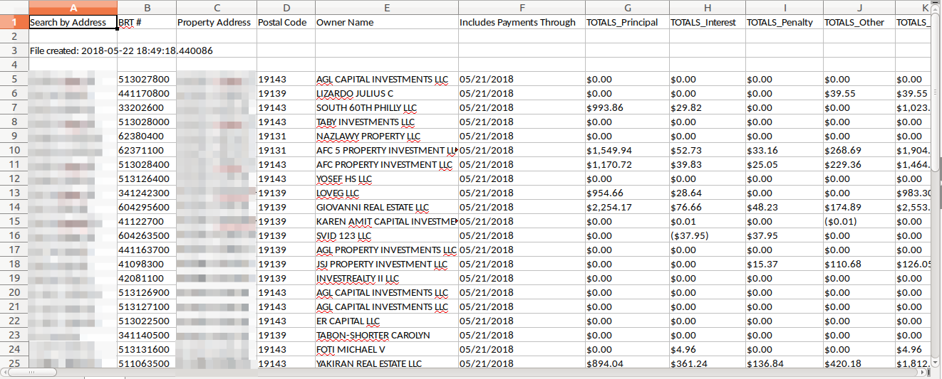
Excel Output Example

Slide 11
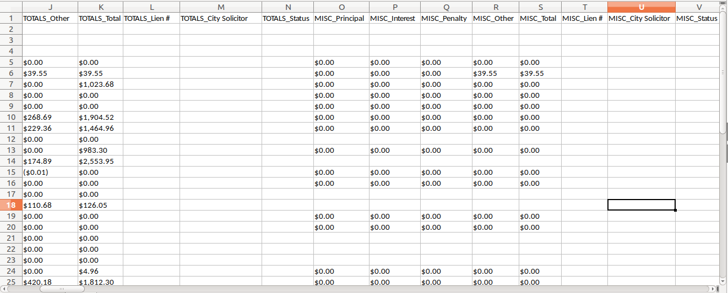
Excel Output Continued

Slide 12
Links
GitHub: https://github.com/kelmore5/philly-real-estate-parser
Slideshow: https://docs.google.com/presentation/d/1VPjsRnpOAuN5QHK1tTbLZbcRY8SmyyCg2Wh8LCeIB-Y/edit?usp=sharing

